Slide 1
Steps of Ordering a List of Unsorted Numbers by Using The Bubble Sort Algorithm
Presented By:
Monoshi Kumar Roy

Slide 2
Algorithm for Bubble Sort
Start with the first element of the list.
Compare each adjacent numbers.
Swap the adjacent numbers if they are not in correct order (Either ascending or descending).
Repeat steps 1-3 until you get the whole list sorted.

Slide 3
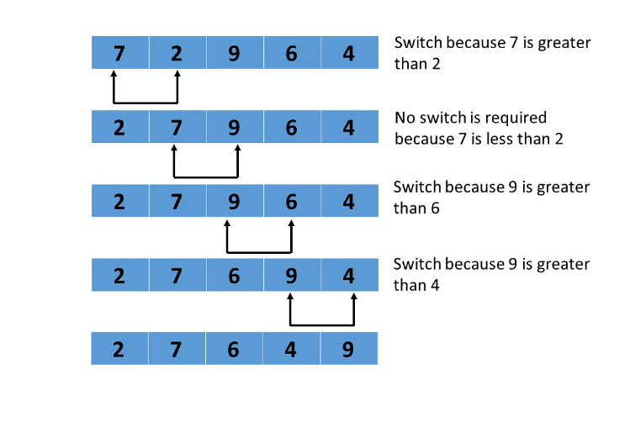
Example of Bubble Sort on a List of Numbers
https://www.simplilearn.com/tutorials/data-structure-tutorial/bubble-sort-algorithm

